Slide 1

THE LOCKHEED-AEROJET DEAL AND ITS ANTITRUST FALLOUT
TEAM 2

Slide 2
Introduction & Context
Deal Announcement : Lockheed Martin, a global aerospace & defense company planned to acquire Aerojet Rocketdyne, a leading supplier of rocket engines & propulsion systems for $4.4 billion.
Key
Vertical
Lockheed Martin aimed to vertically integrate their supply chain, expecting cost synergies and improved efficiency.
02
Aerospace Defense is a highly regulated industry with significant government oversight and a large consolidation trend amongst the contractors. . The Federal Trade Commission (FTC) filed multiple “requests” of information from Lockheed Martin and finally filed a lawsuit in January 2022, arguing that the deal would reduce competition and harm national security interests.
Regulatory
03
Termination
Facing legal pressure, Lockheed abandoned the acquisition, marking a major antitrust intervention in the defense industry.
The Structure-Conduct-Performance (SCP) Paradigm (Bain, 1956) suggests that market structure influences firm behavior and performance.

Slide 3
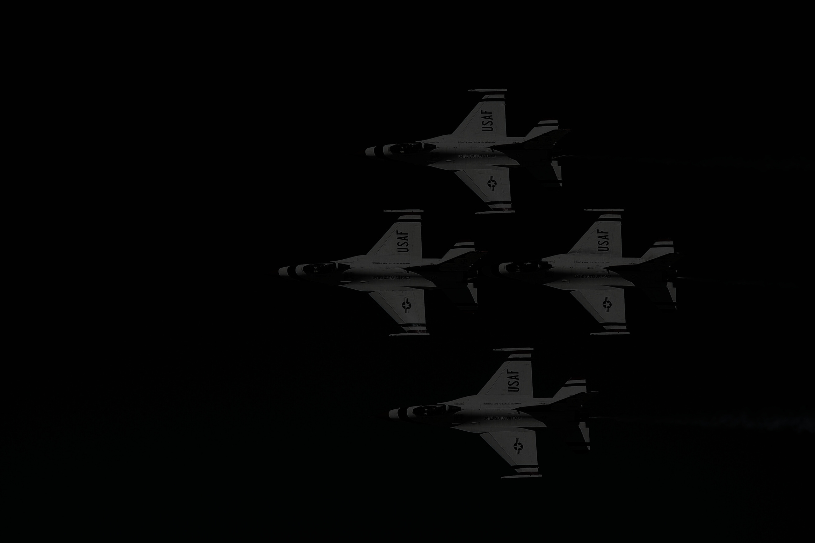
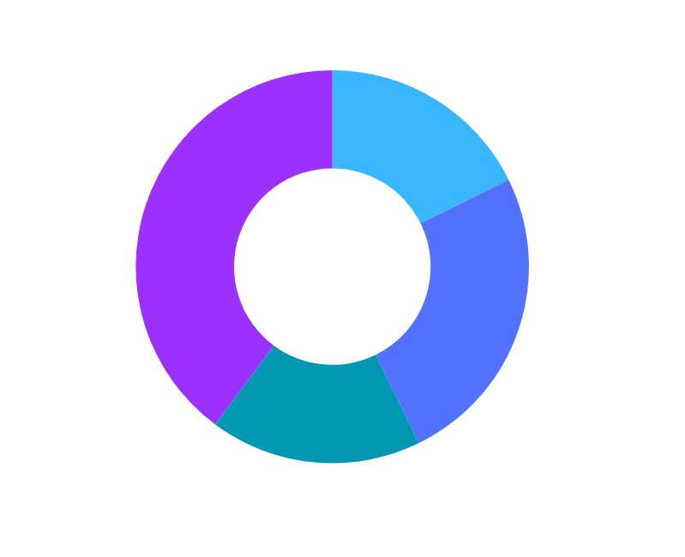
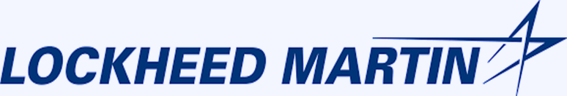
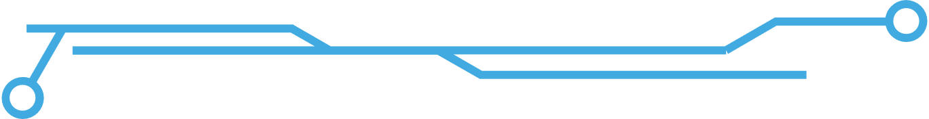
Lockheed Martin Profile
Global Leader
World’s Largest defence contractor by revenue, specializing in advanced technology systems for aerospace, defense, and security.
Vertical Integration
The company continuously acquires suppliers of key components and expand their control. Example; Lockheed Martin acquired Sikorsky Aircraft (2015) for $9 billion, securing control over Black Hawk helicopters and military rotorcraft production.
70% of the revenue comes from government contracts, deals with NASA, allied governments and now foraying into space sector
Financial Strength
Revenue of $66 billion, with a net income of $5.7 billion in 2022. Order backlog of nearly $150 billion showcasing long term growth and revenue stability.
Government Ties

Slide 4

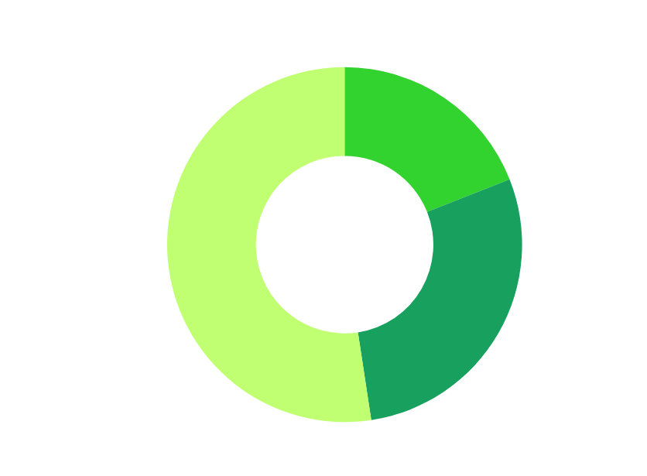
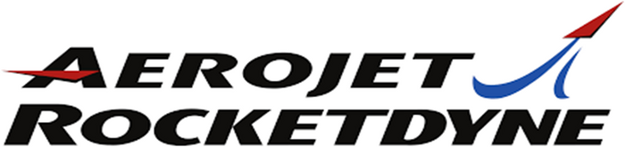

Aerojet Rocketdyne Profile
Propulsion Systems
World leader in propulsion systems, providing proprietary engines and propulsion technology for missiles, rockets, and space exploration.
Advanced Technology
Hypersonic engines and sustainable propulsion solutions with Space Tech in focus. Often called the last indepndent propulsion system firm.
Defence & Space
The company is a key supplier to major defense contractors like Lockheed Martin, Boeing, and Raytheon, as well as government agencies like NASA and the U.S. Department of Defense
Financial Strength
Revenue of $2 billion+ with backlog of nearly $9.4 billion, showing its supply chain value.

Slide 5

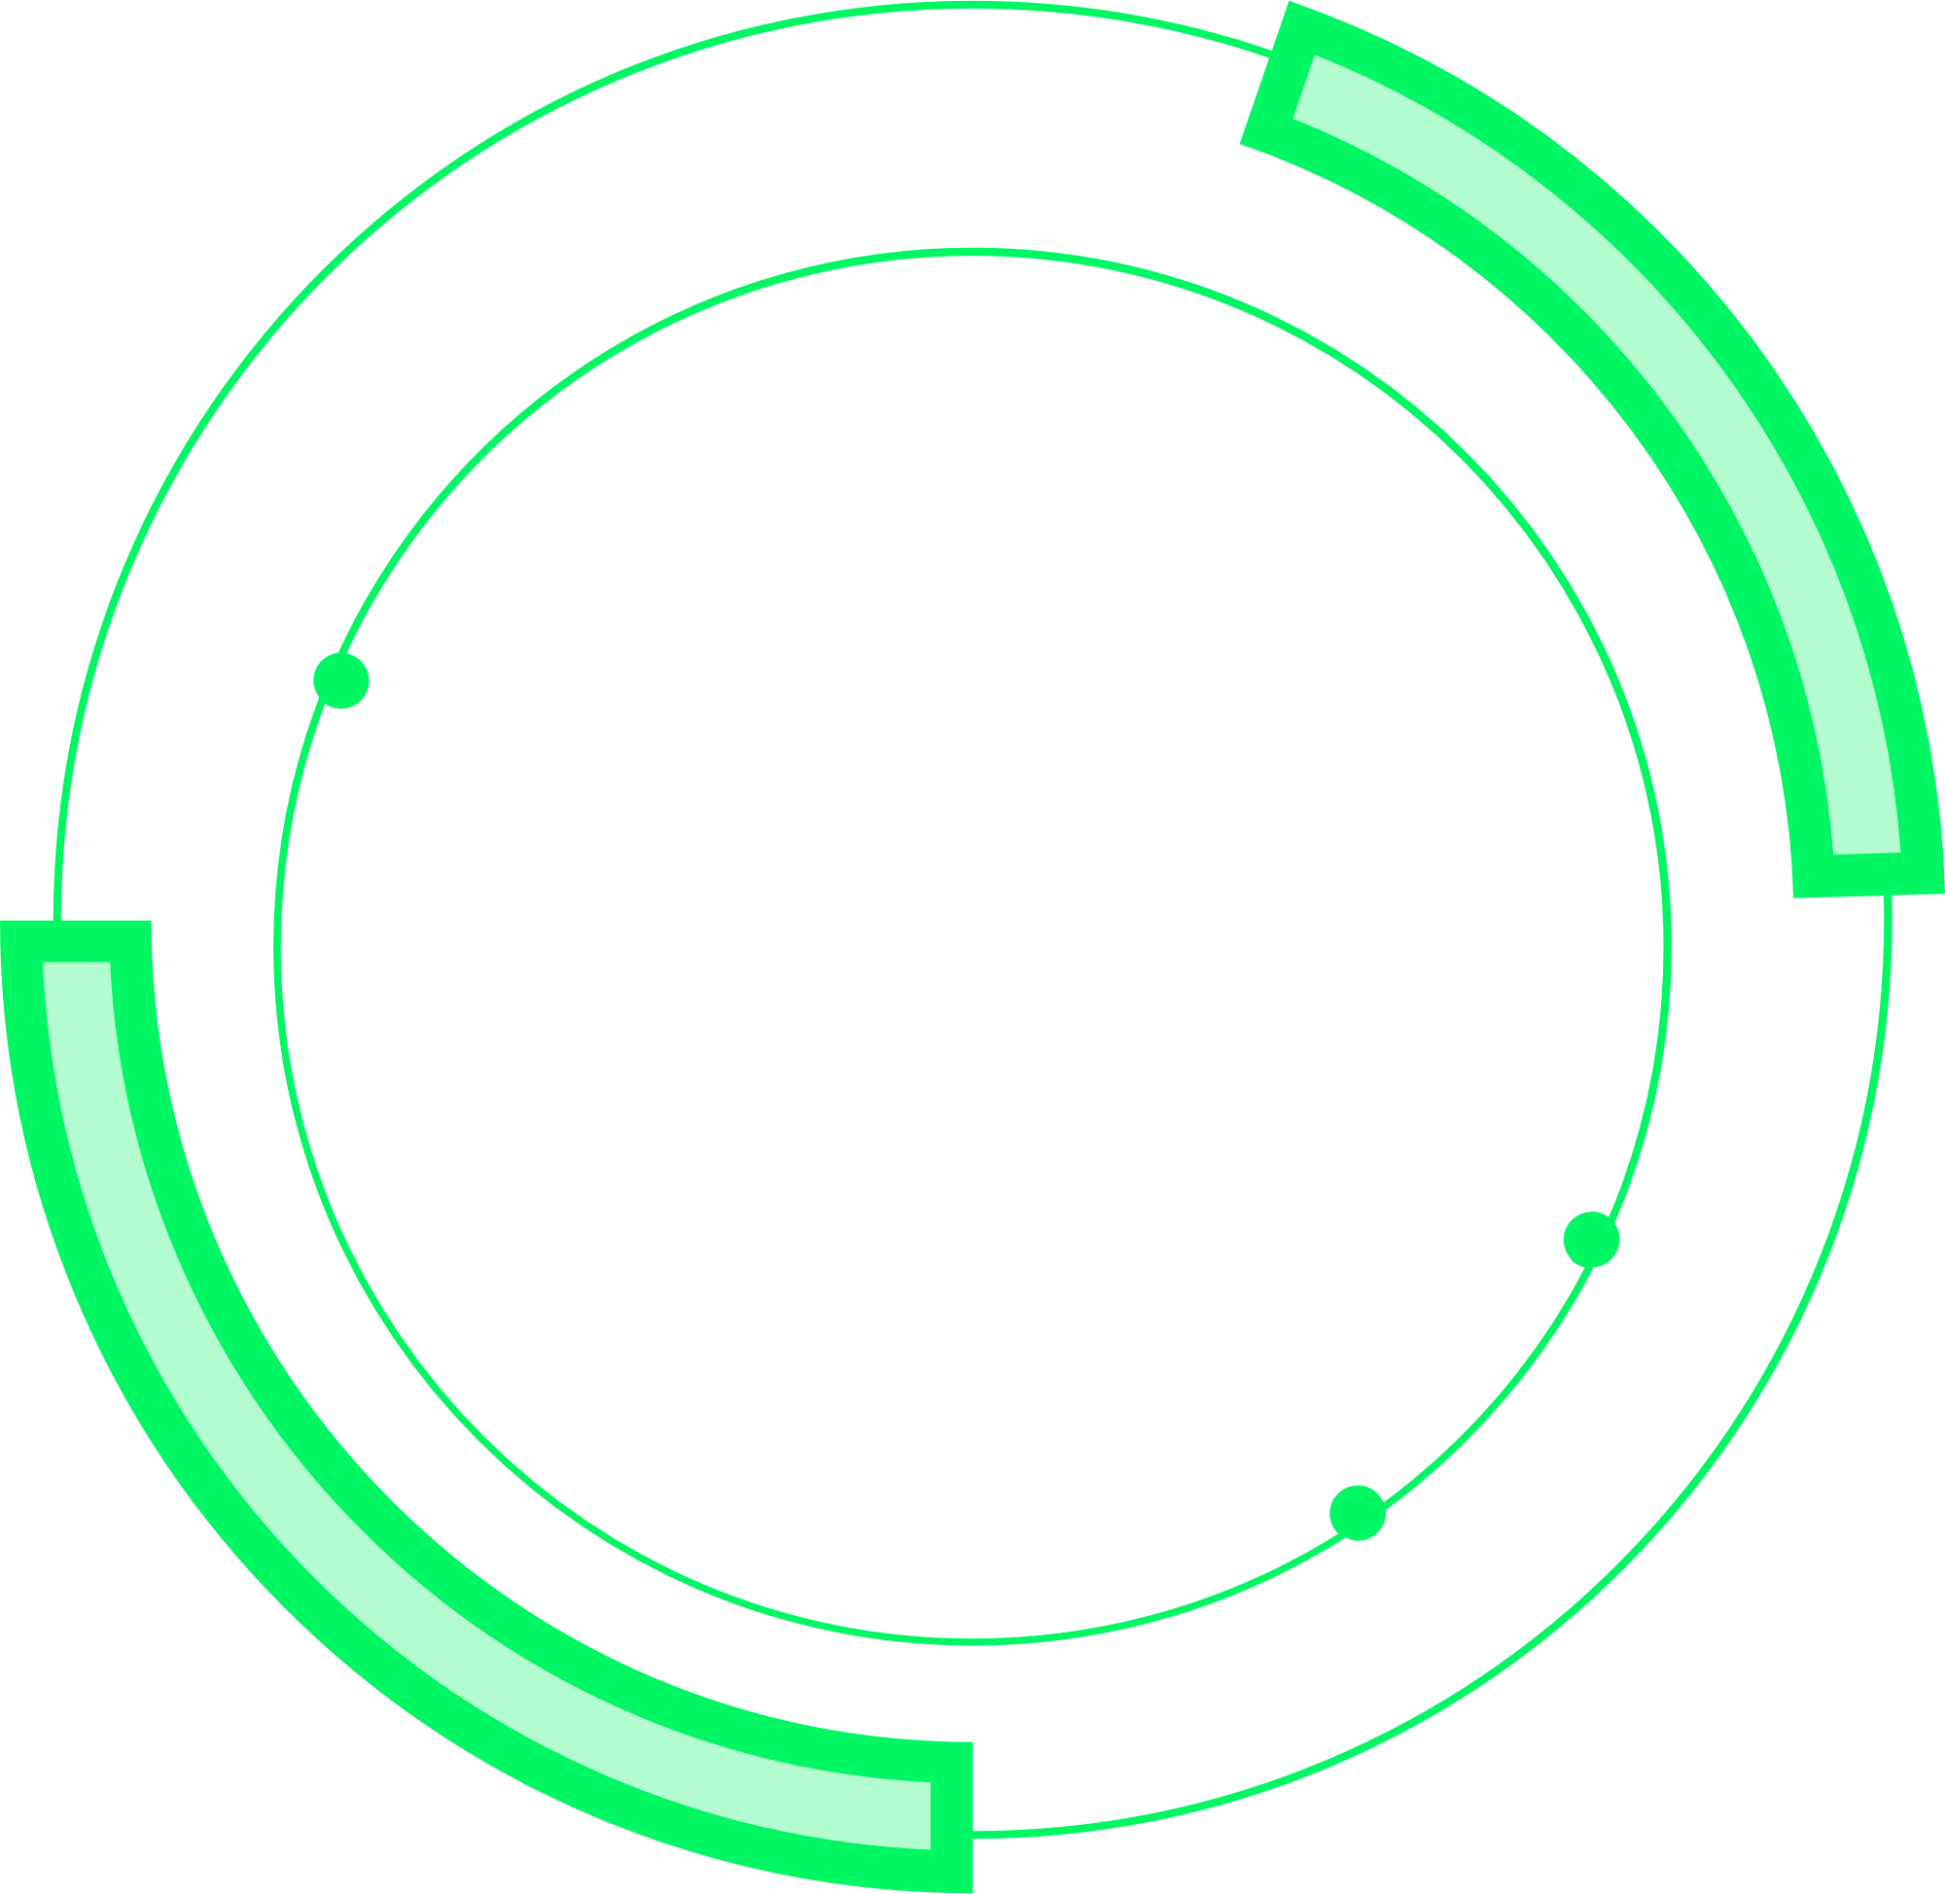
What’s the Deal
Post dividend Equity Value of $4.6 billion
Total Transaction value $4.4 billion
Aerojet Rocketdyne announces dividend
All cash deal. $56 per share in cash. This represented a 33% premium in order to incentivize Aerojet Rocketdyne’s shareholders to approve the deal.
$51 per share after the payment of a pre-closing special dividend
$5 per share to its holders of record of common stock and convertible senior as of the close of business on March 10, 2021, and payable on March 24, 2021.
Vertical M&As aim for cost efficiencies, supply chain control, and reduced dependency on suppliers (Coase, 1937; Williamson, 1975).

Slide 6
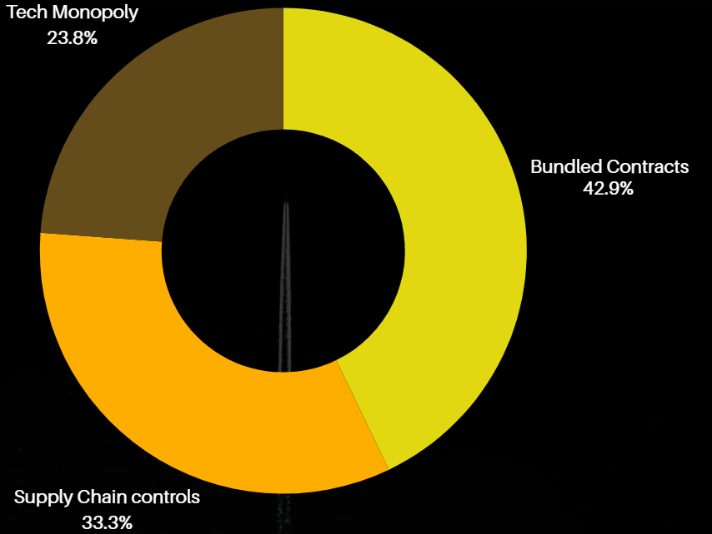
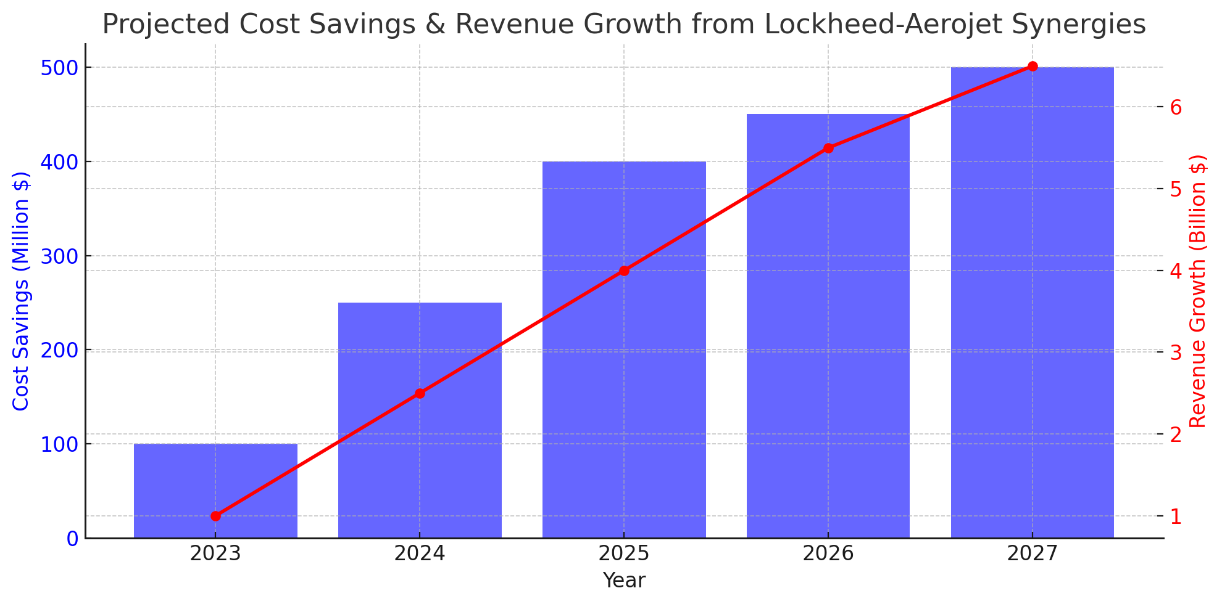
Expected Synergies
Cost synergies
The Lockheed-Aerojet merger promised cost efficiencies, supply chain control, and procurement savings of $400-$500M annually.
Strategic Synergies
Strategically, Lockheed would dominate propulsion, reduce R&D cycles, and with compounded growth, even the space sector
Revenue synergies included securing Pentagon/NASA contracts, expanding hyper sonics, and enhancing pricing power, boosting revenue by $2-4B.
Operation Synergies
Streamlined production, improved quality control, and reduced supply chain risks through vertical integration of Aerojet’s manufacturing processes.
Revenue Synergies
Pricing Power for Lockheed

Slide 7

Timeline
2020
2021
2022
Deal Announced
2021
2022
2022
Senator Report
December 2020. Total Transaction value $4.4 billion
Termination
July 2021, Senator Elizabeth Warren asks FTC to have a more stringent walkthrough.
Feb 2022 Deal terminated
Information Request
Lawsuit
January 2022 FTC Sues citing portection of last independet propulsion system
Fallout
January 2021 First Information Request
Feb 2021 Second request by FTC
July 2022, Board of directors sue each other. Schism due to failed merger

Slide 8


Key Merger & Acquisition Conflicts
ANTITRUST & MARKET CONTROL
Competitor Opposition & Activism
DoD & Shareholders
The FTC argues that this acquisition would significantly reduce competition, handing over keys to critical defense infrastructure and unmitigated control over supply chain ultimately leading to monopoly pricing and a hit on innovation.
Raytheon, a competitor, actively lobbied against the deal arguing that deal could easily block access to technology, hurting industry-wide competition. This can be seen as a “Target Defense” mechanism.
The Department of Defense also expressed concerns about national security, signaling multi-agency opposition. Separately concerns were raised if minority shareholders were being compromised to reach a deal.
"If permitted, the Proposed Acquisition would allow the combined firm to use its control of Aerojet to harm Lockheed’s rivals in ways that would substantially lessen competition in multiple markets for products critical to the national defense.“ - FTC
Defensive strategies in M&A (Jensen & Ruback, 1983) include rival lobbying and regulatory interventions.

Slide 9



Market Reaction
Lockheed Martin
Share prices pre & post-announcement remained market neutral without any knee-jerk reaction.
Information requests form FTC brought about a 2.5% decrease to $332.9.
After the deal was called off, the prices while stable saw an uptick from $370 to nearly $410 in coming weeks indicating a renewed investor confidence.
Aerojet Rocketdyne
Aerojet’s share prices pre-announcement prices which hovered around $42 surged to nearly $55 reflecting 30% increase.
During FTC’s information requests, the share prices declined to $50.75 from $53 as regulatory concerns emerged.
After the deal was dropped, the share prices declined from $42 to $36, a nearly 8% decline.

Slide 10
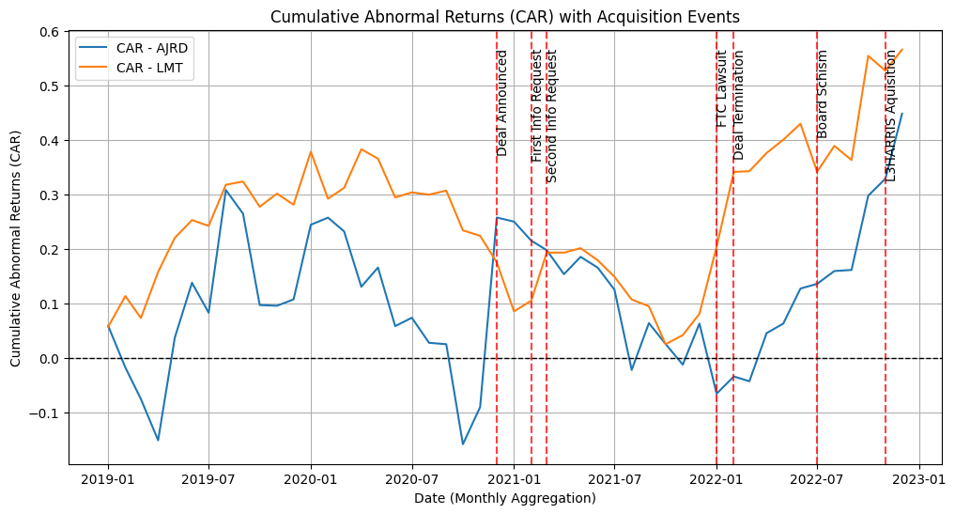
Cumulative Abnormal Returns

Slide 11

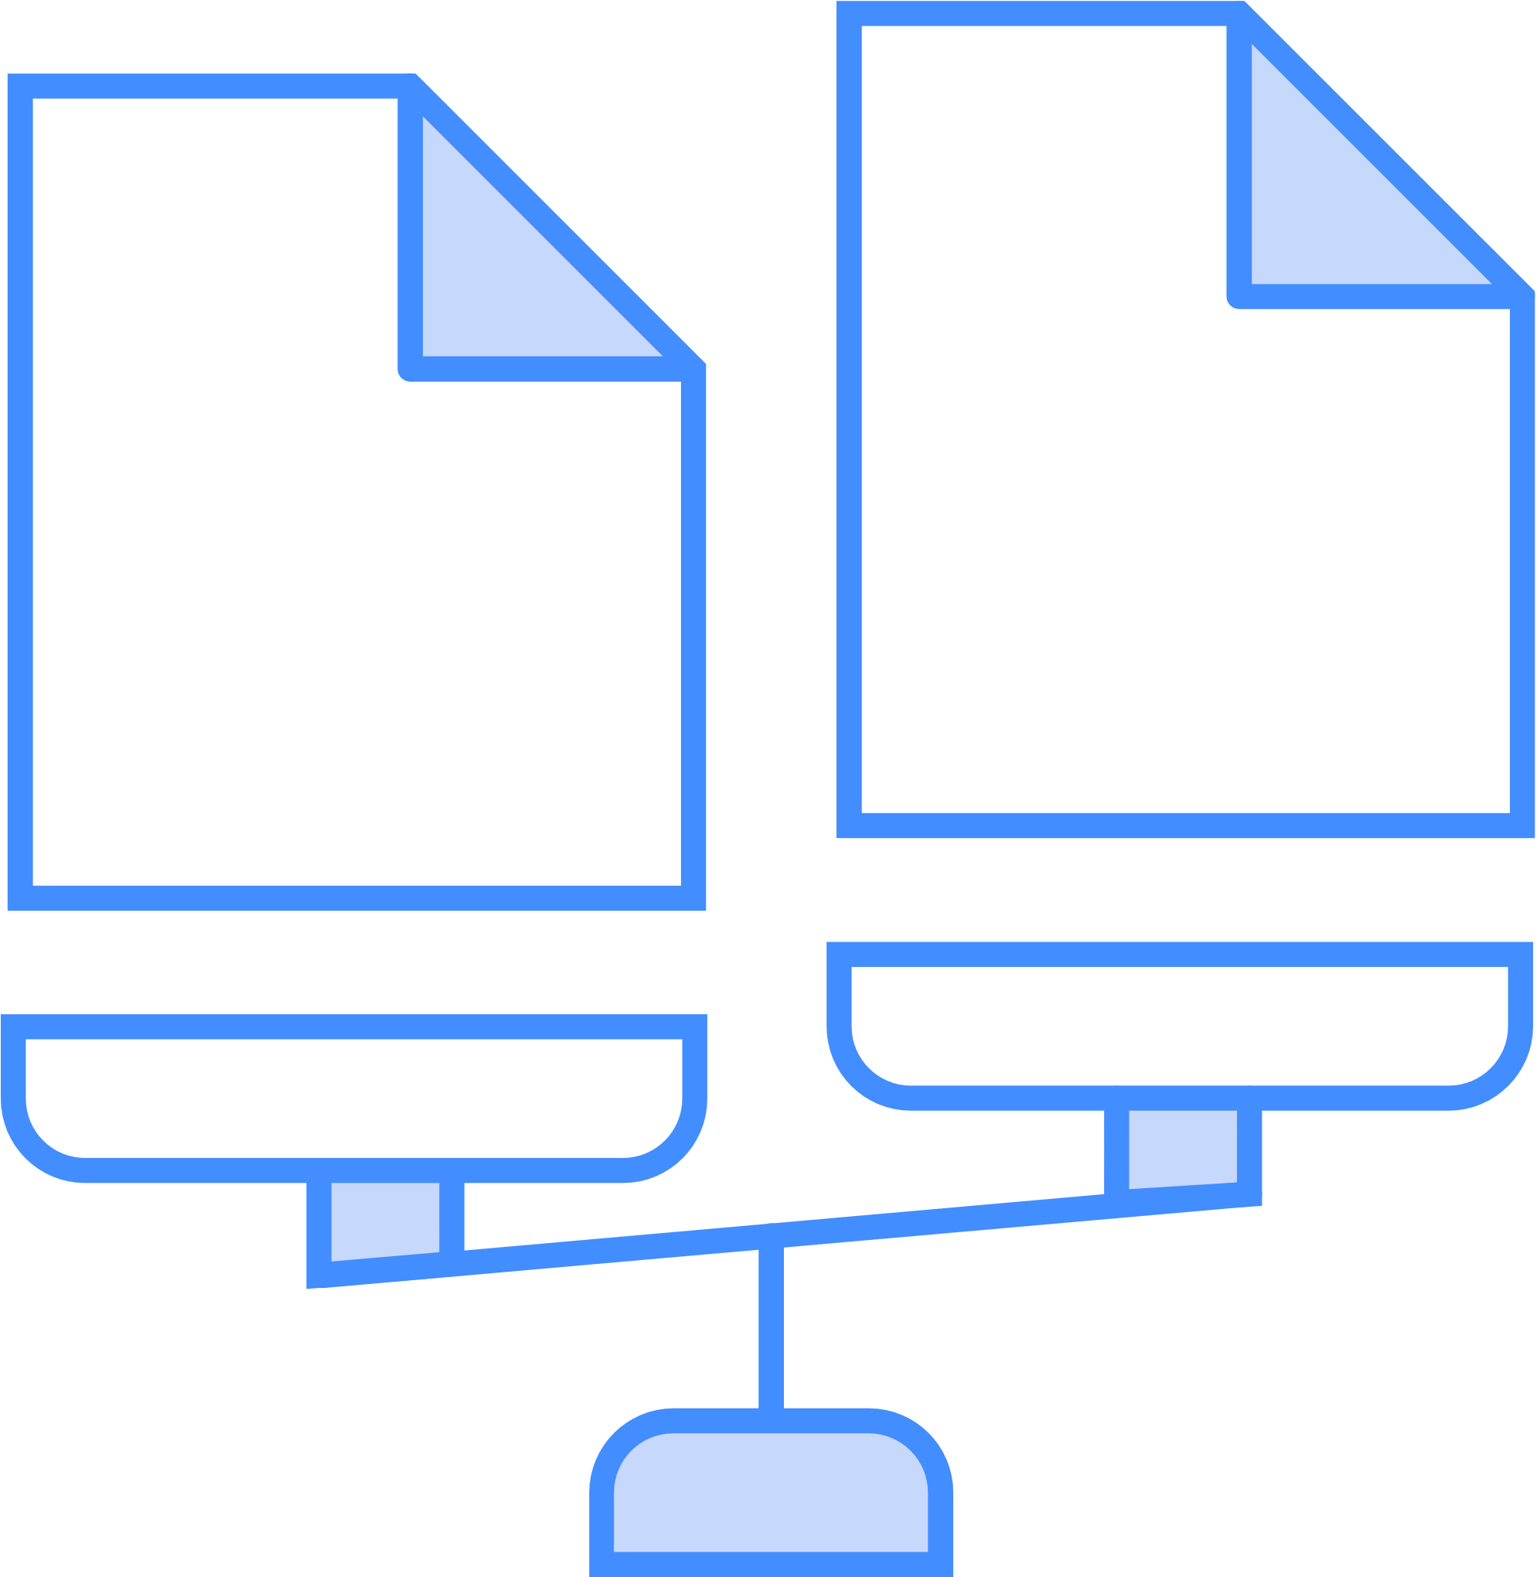
• Theory: Vertical M&As aim for cost efficiencies, supply chain control, and reduced dependency on suppliers (Coase, 1937; Williamson, 1975).
• Application: Lockheed Martin’s rationale for acquiring Aerojet Rocketdyne aligns with this theory, as it aimed to reduce dependency on external suppliers and achieve cost synergies.
Comparative Insights
Comparative Insights
Northrop Grumman-Orbital ATK (2018), defence contractors and raised antitrust concerns, but was approved after divestures.
L3Harris Technologies has completed its acquisition of Aerojet Rocketdyne (same company as our case), with no regulatory pushback.
General Electric-Baker Hughes (2017), aimed for vertical integration and cost synergies and faced fewer regulatory hurdles due to the oil and gas industry’s less stringent antitrust.
“Firms integrate vertically to reduce transaction costs and achieve efficiencies, but excessive integration can create market power concerns.”
Williamson (1975)

Slide 12
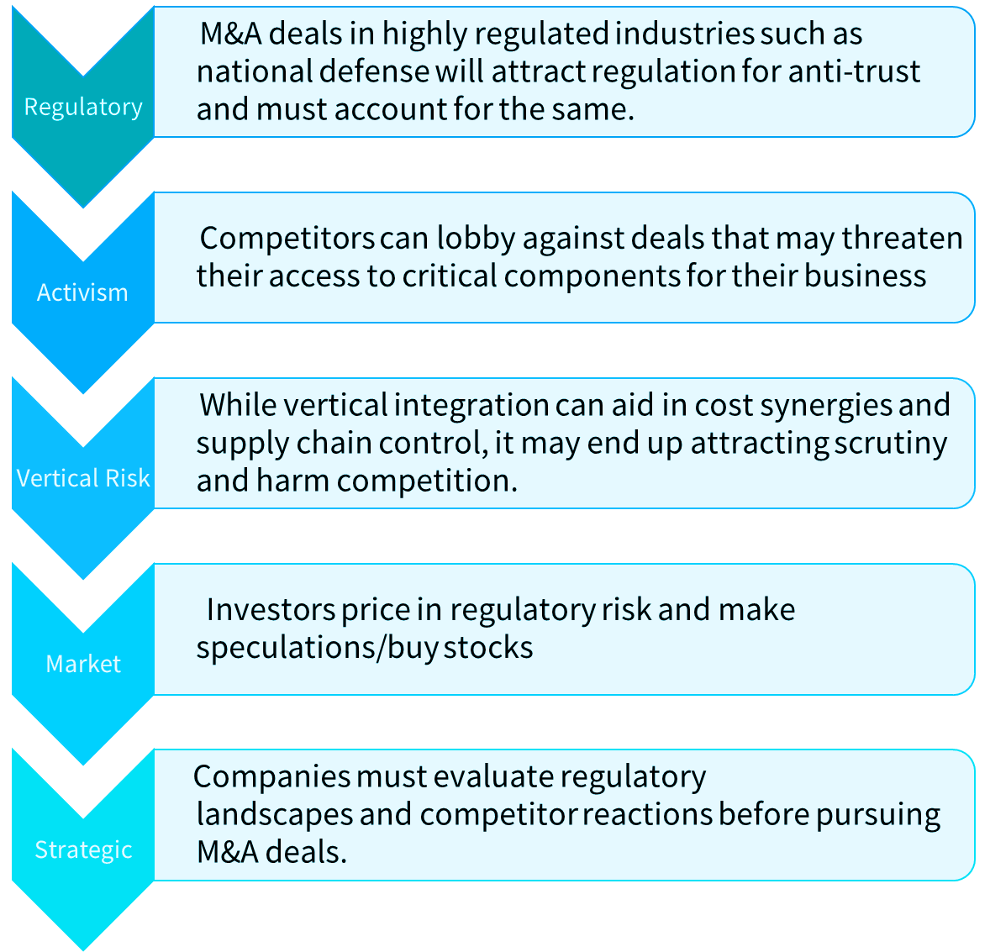

Lessons Learned
“While mergers and acquisitions can create value through synergies and strategic realignment, their success is contingent on overcoming regulatory barriers and competitive resistance. In industries with high government oversight, such as defense, vertical integration can be perceived as anti-competitive, leading to intervention from regulators and lobbying by competitors. Market participants price in these risks, reflecting investor expectations of regulatory scrutiny and deal feasibility”
Jensen & Ruback (1983)

Slide 13

Conclusion
M&A deals in Defense and Aerospace are common, but investors, analysts, and firms must navigate regulatory pushback, competitor opposition, and national security concerns. The Lockheed-Aerojet case highlights growing antitrust scrutiny, shaping future consolidation strategies and emphasizing the risks of vertical integration in sensitive defense sectors

